Slide 1
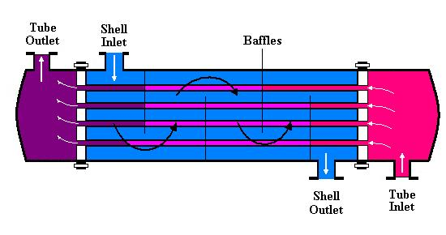














$${LMTD}_{Parallel}=\frac{{(T}_{Hot in}\text{−}T_{Cold in }\text{)−(}T_{Hot out }\text{−}T_{Cold out }\text{) }}{\ln{\frac{{(T}_{Hot in}\text{−}T_{Cold in }\text{)}}{\text{(}T_{Hot out }\text{−}T_{Cold out }\text{)}}}}$$
$${LMTD}_{Counter}=\frac{{(T}_{Hot in}\text{−}T_{Cold out }\text{)−(}T_{Hot out }\text{−}T_{Cold in }\text{)} }{\ln{\frac{{(T}_{Hot in}\text{−}T_{Cold out }\text{)}}{\text{(}T_{Hot out }\text{−}T_{Cold in }\text{)}}}}$$
Parallel flow Heat Exchanger
Counter flow Heat Exchanger
$$T_{Hot in}$$
$$T_{Hot in}$$
$${∆T}_{1 }$$
$$T_{Cold out }$$
$$T_{Hot out }$$
$${∆T}_{1 }$$
$$T_{Hot out }$$
$$T_{Cold out }$$
$${∆T}_{2 }$$
$${∆T}_{2 }$$
$$T_{Cold in }$$
$$T_{Cold in }$$

Slide 2
Co Current Arrangement
Shell Side Pressure drop = 0.25 bar
Tube Side Pressure drop = 0.3 bar
Global Heat Transfer Coeff = 1000 W/m2 K
No heat loss
Cold water 30°C
Hot water 100°C
Hot water 90°C
Cold water 50°C

Slide 3
Counter Current Arrangement
Shell Side Pressure drop = 0.25 bar
Tube Side Pressure drop = 0.3 bar
Global Heat Transfer Coeff = 1000 W/m2 K
No heat loss
Cold water 30°C
Hot water 90°C
Hot water 100°C
Cold water 50°C

